Slide 1
CHORUS SEOUL 2017 LAAO LIVE II
Paroxysmal Atrial Fibrillation Patient Suffering from Recurrent Hematuria During Oral Anticoagulation
Nov. 04. 2017
Chung-Ang University Hospital
Cardiovascular & Arrhythmia Center
SEOUL, COREE

Slide 2
Brief Case Summary
Age / Sex: 75 / Male
C/C: Recurrent hematuria during anticoagulation (Dabigatran 110 mg bid)
Past medical history
# Paroxysmal Atrial Fibrillation (2016)
# Sick Sinus Syndrome (DDDR Pacemaker, 2016)
# s/p Cerebral infarction (2016)
# Diabetes mellitus, Hypertension
CHA2DS2VASc score = 6
HASBLED score = 4
Notes:
MRN: 00682213 (SCD)

Slide 3
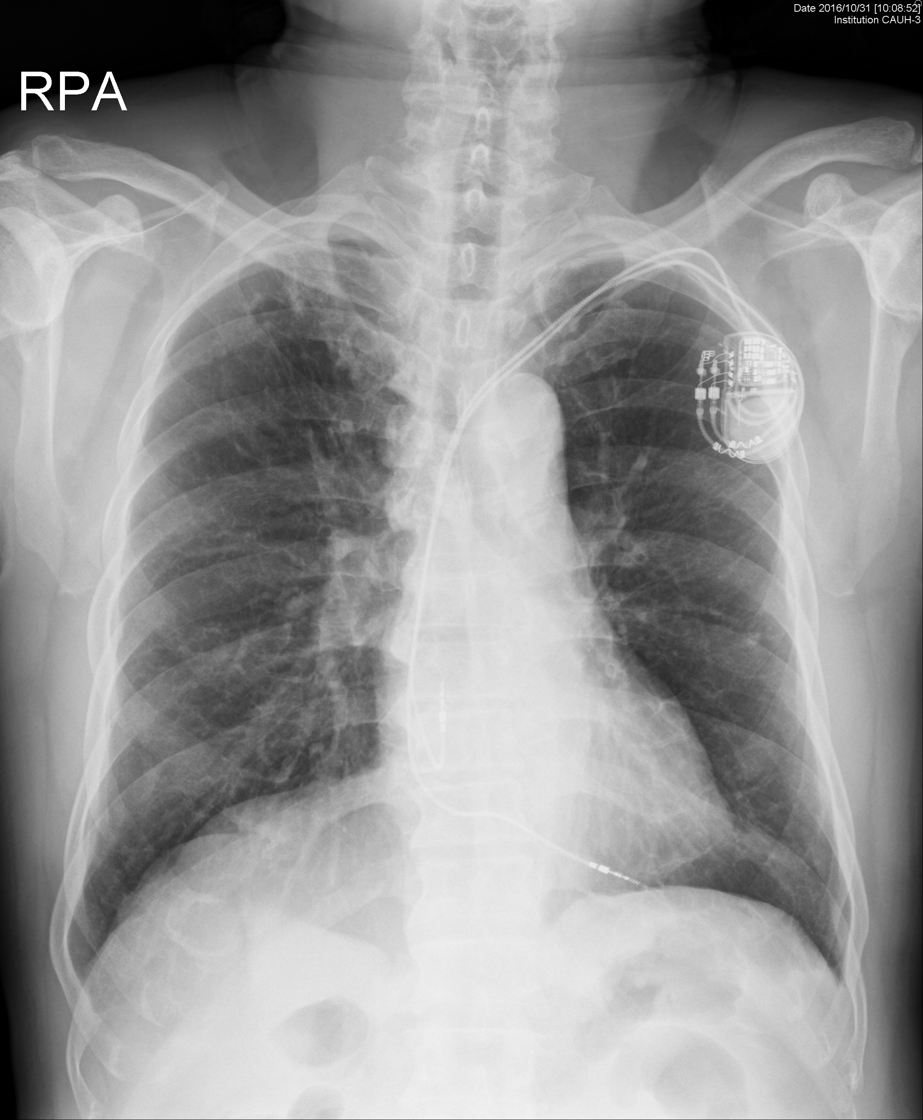
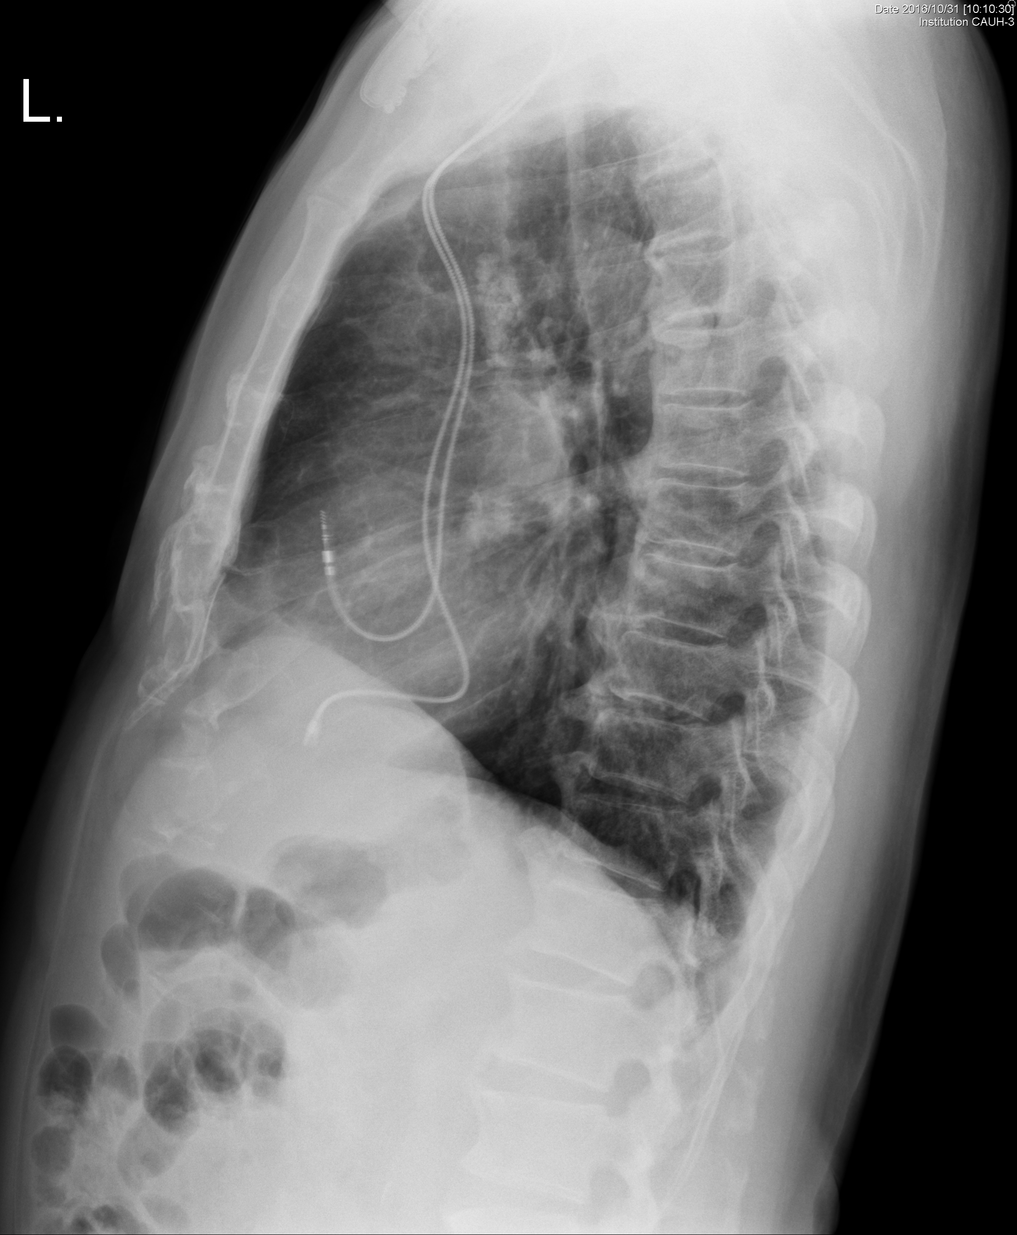
CHEST X-Ray

Slide 4
EKG
Atrial fibrillation with ventricular pacing

Slide 5
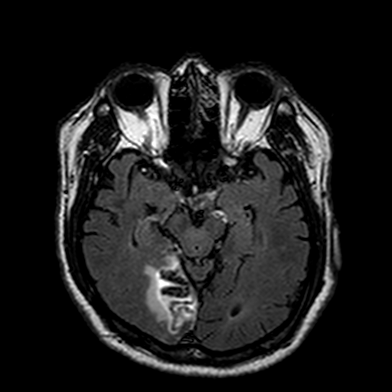
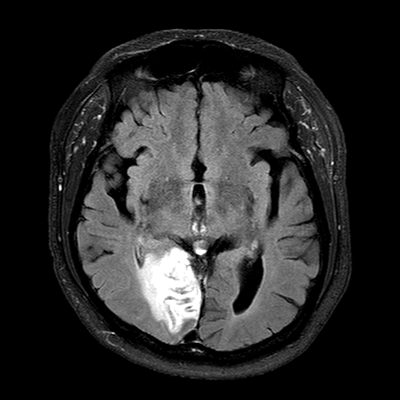
Brain MRI (2016)

Slide 6
Echocardiography
LA 47 mm, LVEF 57 %

Slide 7
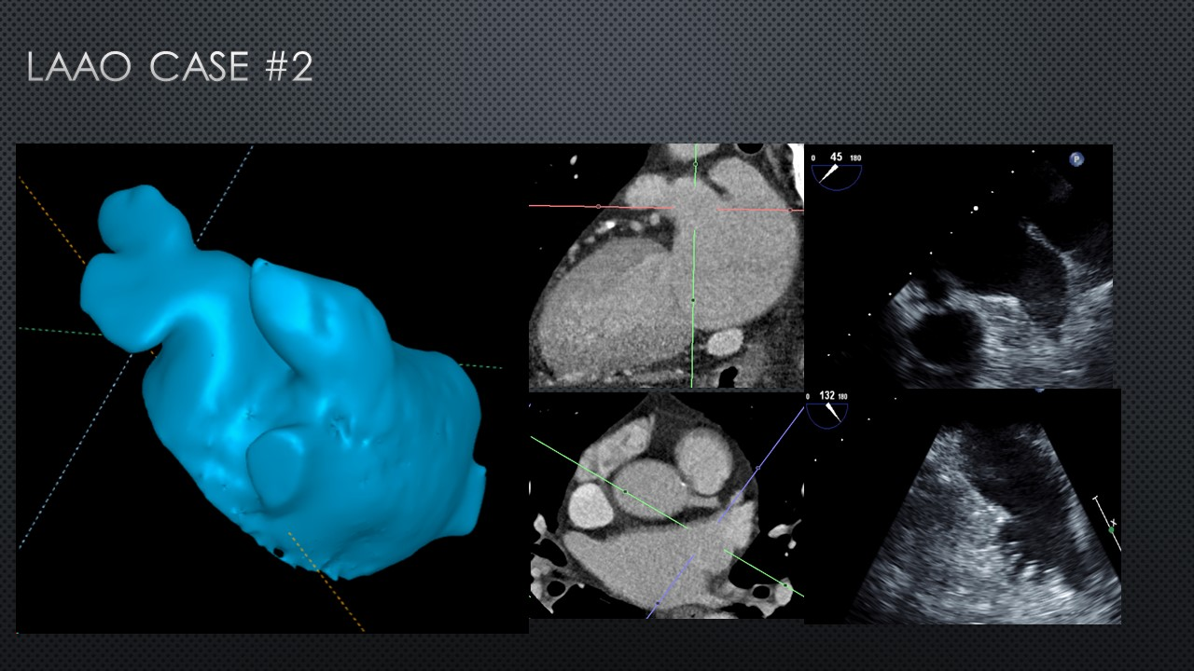
Cardiac CT

